Slide 1

Smart Cities Project
Lessons 21–27

Slide 2
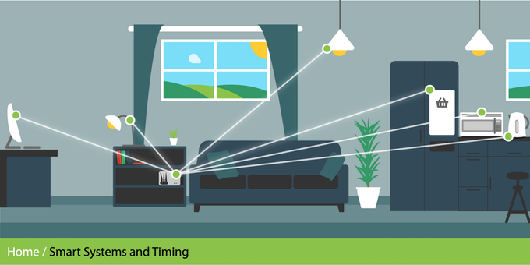
What is IoT?
Internet of Things
Adding electronics to everything
Electronics such as:
Sensors (cameras, temp, light, humidity etc.)
Microprocessors
Transmitters
Screens
GPS
RFID
Everything can link to the internet/ each other
Anything electronic can be controlled
Can stream data continuously

Slide 3













Example: Internet of Things
Internet of Things devices need:
Sensor
MCU
Radio
Security
Connectivity
Services
ARM has high share of technology components needed to create a smart, secure connected device
ARM-based technology is the platform for many Internet of Things devices
advanced* microcontrollers
wireless connectivity
advanced smartcards
wearables
drones
connectivity in cars
* Advanced 32-bit devices

Slide 4
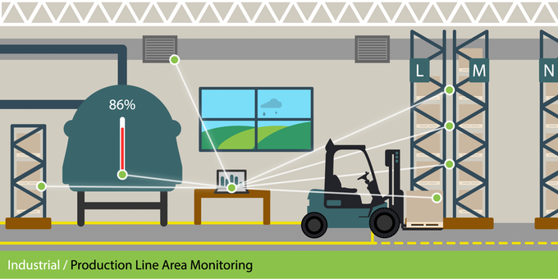
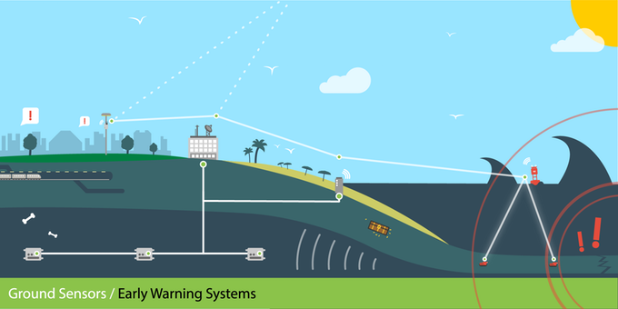
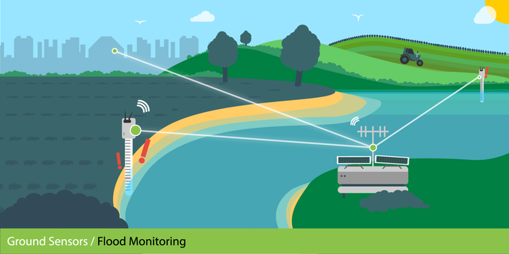
Sensing the World
What else could IOT devices be used for?
Think about their use in:
Law enforcement
Medicine
Retail
Cars

Slide 5
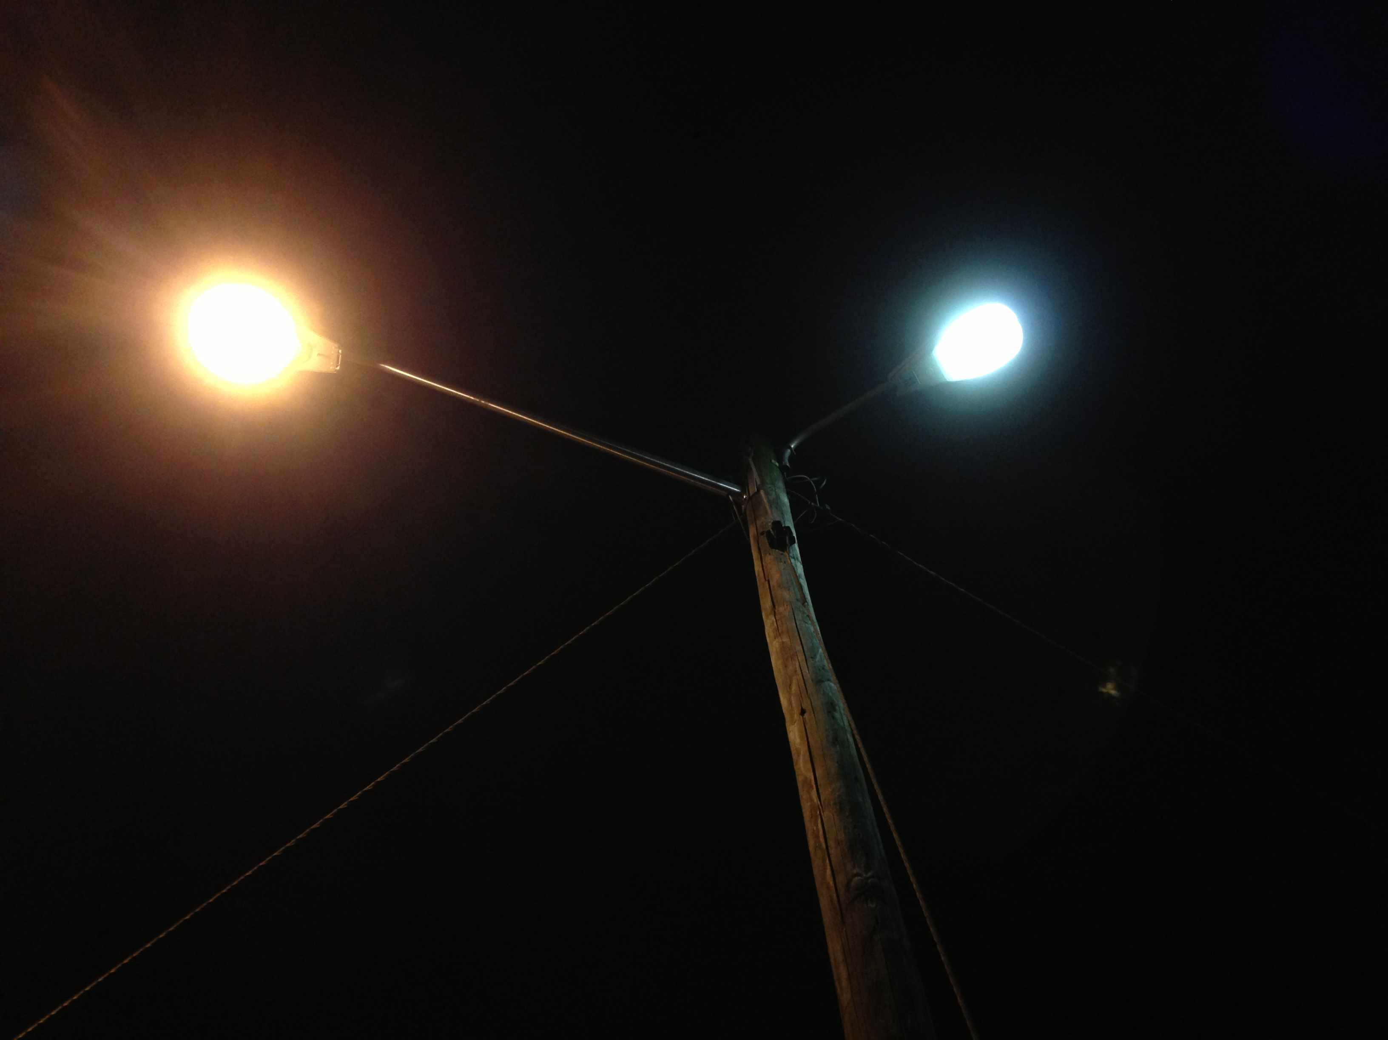
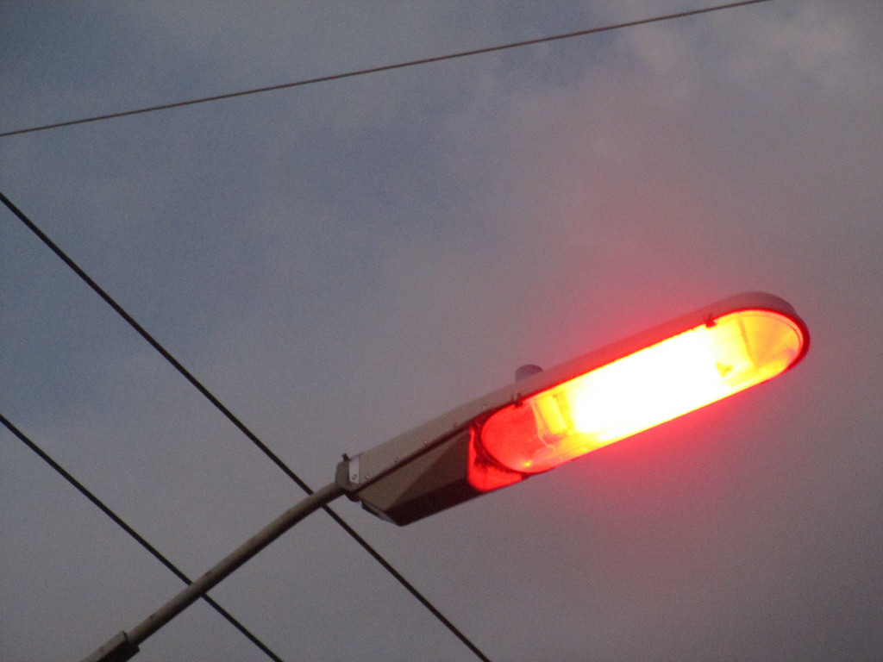
Dumb Street Lights
Turn on and off at a given time
Use Halogen/Sodium bulbs
Inefficient
End of life

Slide 6

The Challenge
The Mayor needs to replace all of your city’s street lights
He has asked you to design and build a new smart street light prototype
You have 7 lessons (including this one)

Slide 7
Activity
Using the IPO worksheet design some features for your smart street light
Example:
Input
Process
Output
Light sensor | When light gets below a given level | Turn light on
Light sensor | When light gets above a given level | Turn light off

Slide 8
Lesson 2

Slide 9
Input, Process, Output (IPO)
Process
Output
Input
Sensors (produce data)
Temperature sensor
Light sensor
Accelerometer
Magnetometer
Pressure sensor
Humidity sensor
Light and colour sensor
Microphone
Camera
Wifi
Bluetooth
GPS
Takes input data
Does something with the data
Stores the data
Transmits the data
Motors/servos
LEDs
Sound
GPS
Wifi
Bluetooth
Radio
LoRa

Slide 10
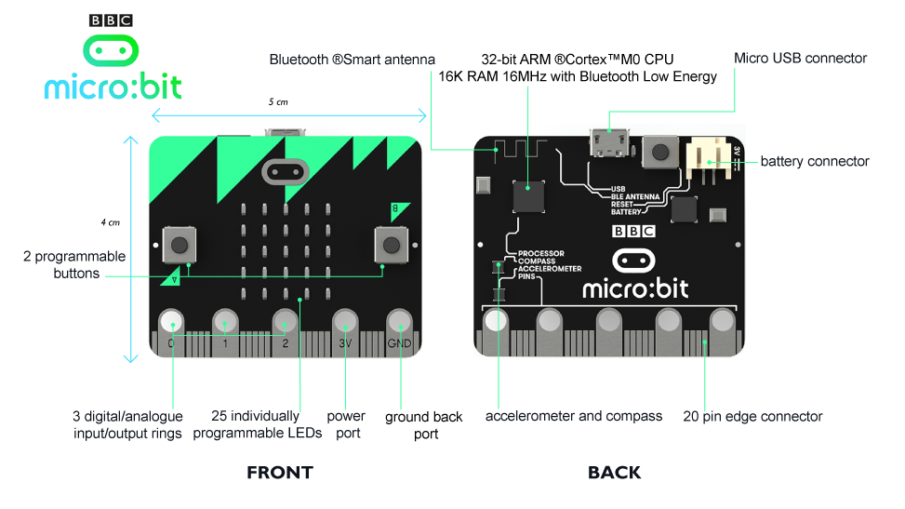

Slide 11
Success Criteria
Design a street light that changes its behaviour depending on the local conditions
Design the body of the street light to be efficient and robust
Design the light housing to minimise light pollution
Create a program that uses the micro:bit’s sensors to make the street light smart
Create a smart street light that uses LEDs to save electricity usage
Consider how the data generated by smart street lights could be used
The city wants you to suggest ways the data collected from the sensors in the street lights across the city could be used by other organisations

Slide 12
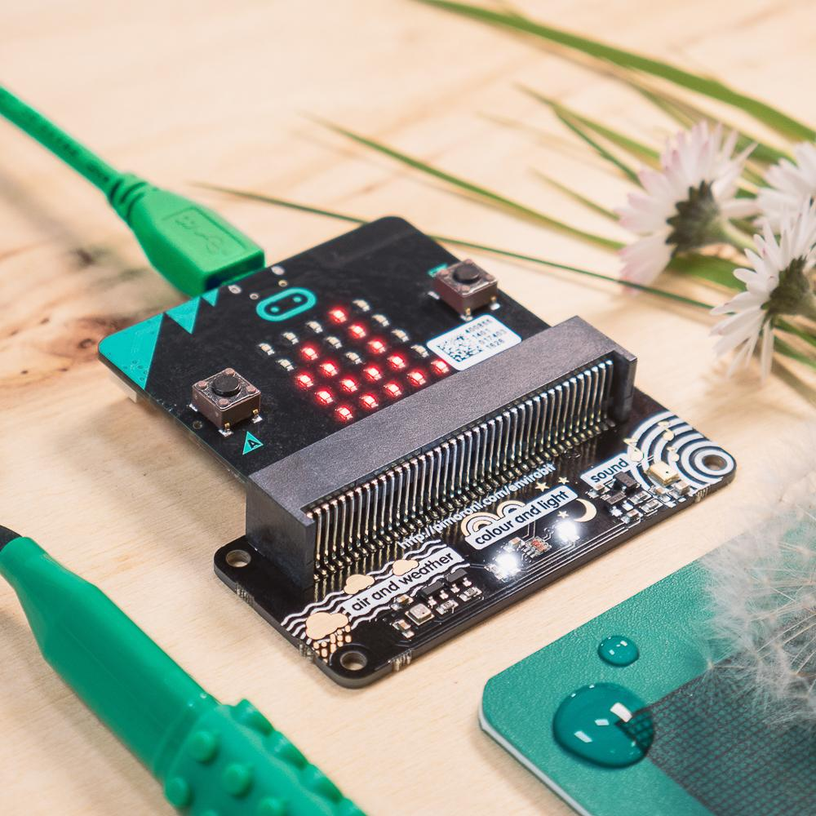
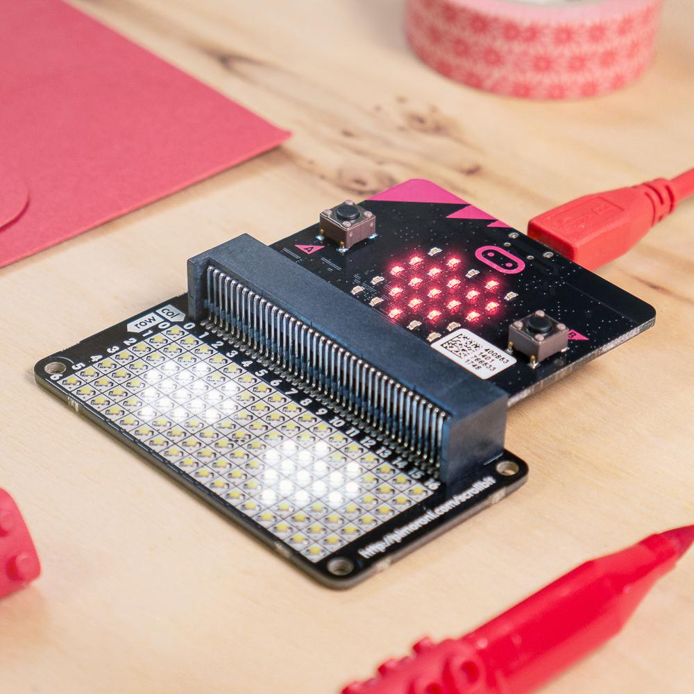
The Design Challenge
Your team have been asked to design a smart street light to replace a city’s aging lights
The lights can use IoT technology to add new features to street lights
Your design must meet the Success Criteria
For the prototype you will have access to:
enviro:bit
scroll:bit

Slide 13
Sensing the Surroundings
micro:bit sensors enviro:bit | micro:bit | scroll:bit (LED)
Input
Process
Output
Sensors built into the micro:bit:
Temperature sensor Light sensor Accelerometer Magnetometer | Trigger outputs based on thresholds, timings etc | LED matrix
External peripherals (enviro:bit and scroll:bit)
Temperature sensor Pressure sensor Humidity sensor Light and colour sensor Microphone | Controlled by a micro:bit | 17×7 white LEDs Individual brightness control Radio Bluetooth

Slide 14
Activity
Using the design sheet, design a modern street light
Describe its features
Design the IPO for the light
Think about how the lights could help people

Slide 15
Lesson 3

Slide 16
Success Criteria
Design a street light that changes its behaviour depending on the local conditions
Design the body of the street light to be efficient and robust
Design the light housing to minimise light pollution
Create a program that uses the micro:bit’s sensors to make the street light smart
Create a smart street light that uses LEDs to save electricity usage
Consider how the data generated by smart street lights could be used
The city wants you to suggest ways the data collected from the sensors in the street lights across the city could be used by other organisations

Slide 17
Working in Parallel
Designing/Making the product
Programming the product
Marketing
Complete the design sheet
Gather the materials
Make the product
Add the micro:bits
Test the product
Evaluate
Improve
Plan the interactions
Program the micro:bit
Test the functionality
Add the micro:bits to the product
Test the product
Evaluate
Improve
Write the elevator pitch based on the designs
Create a logo
Create a 1 page website
Logo
Information about the product
Why the product solves a problem
The unique selling points
A picture of the finished light

Slide 18
Get Designing!
Read the design brief document
Using the provided Design Templates design a smart street light
Think about the sensors that are present
Think about the IPO process
Think about how the data can be used to improve people lives

Slide 19
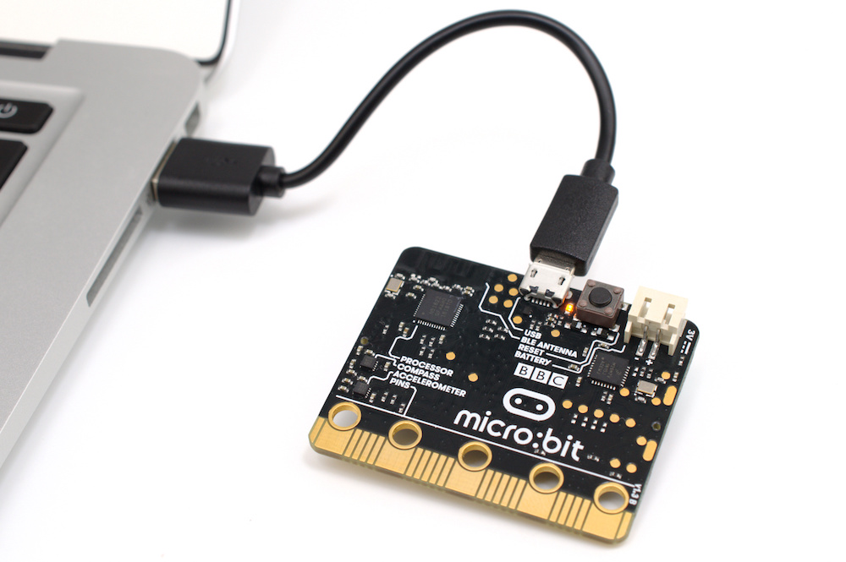
Make a program on MakeCode
Download the .hex to the PC
Transfer the .hex to the micro:bit

Slide 20
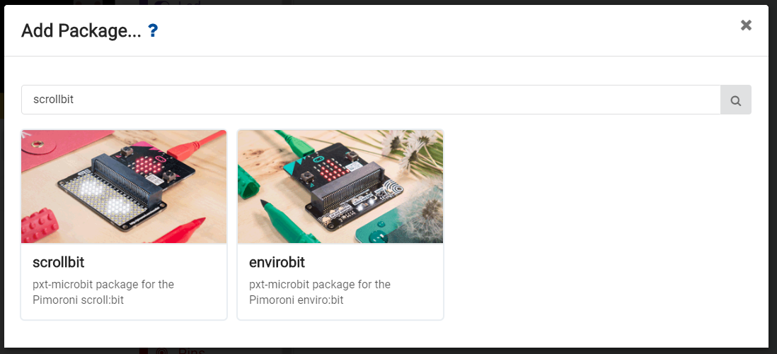
Adding Libraries
You can only add one peripheral at a time to the micro:bit
To make use of both you will need two micro:bits
Both the enviro:bit and the scroll:bit work with MakeCode but you will need to add the packages to MakeCode
Click Advanced then Add Package then search for ‘scroll:bit’ and ‘enviro:bit’
***You can only add one package at a time, adding both packages is possible but any programs made will not work***

Slide 21
Equipment Needed
You will need for the street light:
2×micro:bits
1×scroll:bit
1×enviro:bit
Building materials
card
scissors
pens
etc

Slide 22
Success Criteria for the Build
The street light must:
Be 30cm tall
Minimise light pollution (scroll:bit)
Be robust
Use the available sensors (enviro:bit)
Be smart (use other micro:bits for this!)

Slide 23
Lesson 4

Slide 24
Additional Considerations
The street light should not exceed the footprint of a traditional street light
The street lights can be connected to the internet if needed
The Environment Agency is very keen for the lights to be as efficient as possible, in terms of both materials used and power consumed, to minimise the environmental impact
Consider what other sensors could be added to improve functionality

Slide 25
Success Criteria
Design a street light that changes its behaviour depending on the local conditions
Design the body of the street light to be efficient and robust
Design the light housing to minimise light pollution
Create a program that uses the micro:bit’s sensors to make the street light smart
Create a smart street light that uses LEDs to save electricity usage
Consider how the data generated by smart street lights could be used
The city wants you to suggest ways the data collected from the sensors in the street lights across the city could be used by other organisations

Slide 26
Stretch Tasks
The government has noticed how well you are doing and they have asked you to think about some additional challenges as part of this project
These are listed in the Stretch Tasks worksheet
Example:
Community Noticeboard
The community want a noticeboard on the street light where they can post about lost pets, local events and community groups.
People will create a notice at home, send it for approval and then have it displayed
Design the system using a flow chart
Connect your micro:bit to a display to create the noticeboard

Slide 27
Lesson 5

Slide 28
Additional Considerations
The street light should not exceed the footprint of a traditional street light
The street lights can be connected to the internet if needed
The Environment Agency is very keen for the lights to be as efficient as possible, in terms of both materials used and power consumed, to minimise the environmental impact
Consider what other sensors could be added to improve functionality

Slide 29
Success Criteria
Design a street light that changes its behaviour depending on the local conditions
Design the body of the street light to be efficient and robust
Design the light housing to minimise light pollution
Create a program that uses the micro:bit’s sensors to make the street light smart
Create a smart street light that uses LEDs to save electricity usage
Consider how the data generated by smart street lights could be used
The city wants you to suggest ways the data collected from the sensors in the street lights across the city could be used by other organisations

Slide 30
Stretch Tasks
The government has noticed how well you are doing and they have asked you to think about some additional challenges as part of this project
These are listed in the Stretch Tasks worksheet
Example:
Community Noticeboard
The community want a noticeboard on the street light where they can post about lost pets, local events and community groups.
People will create a notice at home, send it for approval and then have it displayed
Design the system using a flow chart
Connect your micro:bit to a display to create the noticeboard

Slide 31
Lesson 6

Slide 32
Elevator Pitch
Create an elevator pitch to sell your idea to government officials
Your pitch must be no more than 2 minutes
You can create a slideshow to accompany your
Be prepared for questions!

Slide 33
Marketing
You need to develop some marketing material to advertise your product to other cities/countries. You must use appropriate software for the task.
You need to create:
a logo (digital)
A 1 page website (a mock-up will do if the tools are not available)
Logo
Information about the product
Why the product solves a problem
The unique selling points
A picture of the finished light

Slide 34
Lesson 7

Slide 35
How Your Teams Will Be Judged
Originality/creativity of the idea/solution
Teamwork
Elevator pitch
Quality of design adaptation
Build quality of the prototype
Marketing
Bonus points for stretch tasks!

Slide 36
Reflection and Evaluation
Complete the Reflection and Evaluation worksheet
Say what went well and what could have been done better

